Slide 2


C# - Cloud to Mobile
@slodge
Survival, Inquiry, Sophistication

Slide 3
What we’ll be talking about
C# Cloud
C# Clients
C# Cloud-Client Communication
C# Code
Real App Examples
Q&A

Slide 4

Survival, Inquiry, Sophistication
How can we eat?
Why do we eat?
Where shall we have lunch?
“The History of every major Galactic Civilization tends to pass through three distinct and recognizable phases, those of Survival, Inquiry and Sophistication, otherwise known as the How, Why, and Where phases. For instance, the first phase is characterized by the question 'How can we eat?' the second by the question 'Why do we eat?' and the third by the question 'Where shall we have lunch?”
― Douglas Adams, The Restaurant at the End of the Universe

Slide 5
Why C#?
Shared code across mobile and cloud
“low level”: compiles, typesafe, quick
Native performance
Native look and feel
Testable
Libraries: commercial and open – and nuget!
Generics, Linq, async/await and the future…
You already have: skills, tools, code

Slide 6
Why Azure?
Storage – lots of it
Connectivity – lots of it. Continuous. Global
Processing – lots of it. Scalable. Burstable.
Privacy/Security
Quick updateability
Toys – ACS, Queuing, CDN, TrafficManager, Caching, Services, …

Slide 7
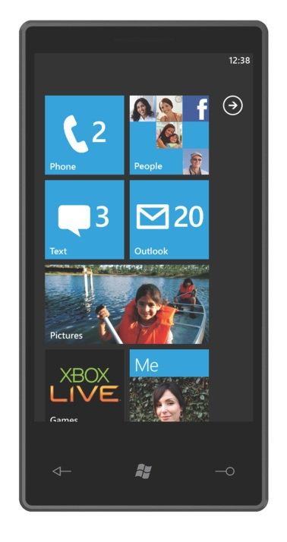
Examples: Lottery Results
Push
Web Role
Worker Role
Storage

Slide 8
Important
Azure is:
big
cheap
Azure is not:
infinite
free

Slide 9
Demo: Code
TweetPic
Azure Storage
SQL
Azure
Azure
Website

Slide 10
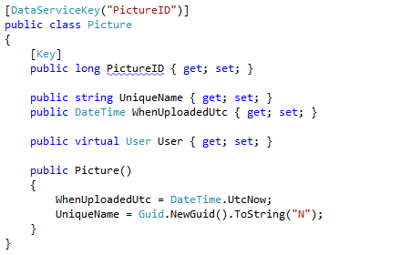
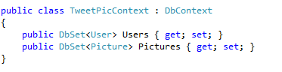
Storage: SQL via EF Code First

Slide 11
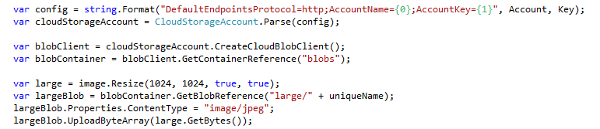
Storage: Azure Blob Uploads

Slide 12
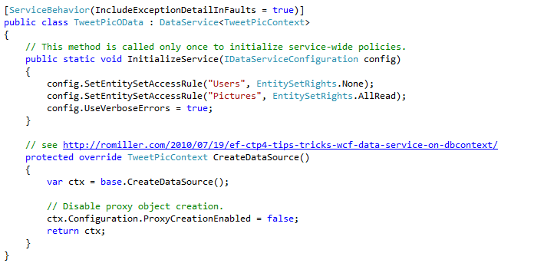
Data Services: WCF oData

Slide 13
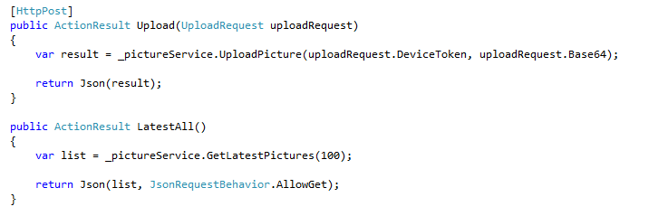
Data Services: Json ASP.Net MVC

Slide 14
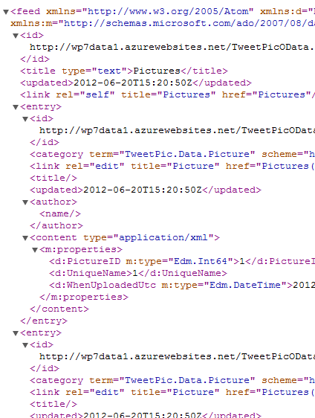
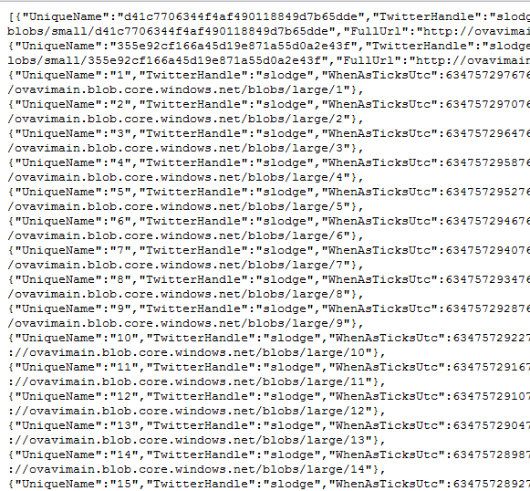

Size Matters
XML
JSON list of 100 pictures
JSON
Gzip JSON
58kB
21kB
2kB

Slide 15
TweetPic Server
Sophistication: Lots of C# Server technologies are available:
nHibernate
RavenDB
Lucene.Net
MVC Async (+SignalR)
ServiceStack
Azure - Access Signatures
WebAPI
OpenRasta
Simple.Web
Nancyfx
FubuMvc
ASMX and WebForms
ProtocolBuf.Net
…
Server:
Storage:
Code First Entity Framework
Azure C# SDK
Logic/Services:
Custom C#
Twitterizer
Presentation:
ASP.NET MVC (Json)
WCF (oData)

Slide 16
Survival: Simple TweetPic Client
WP7
XAML
+ C# CodeBehind

Slide 17
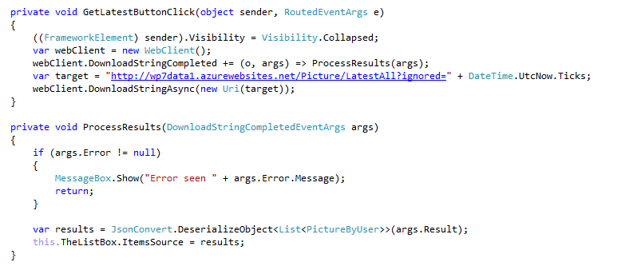
Survival: Simple TweetPic Client

Slide 18
Inquiry: TweetPic Client
Service Consumption
Local Data/Services
Business Logic
UI Logic - ViewModels
Presentation - WP7 – XAML

Slide 19
Sophistication: TweetPic Clients
Service Consumption
Local Data/Services
Business Logic
UI Logic - ViewModels
WP7 – XAML
Win8 – XAML
iOS – XIB/MT.D
Droid – AXML

Slide 20
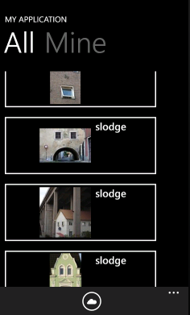
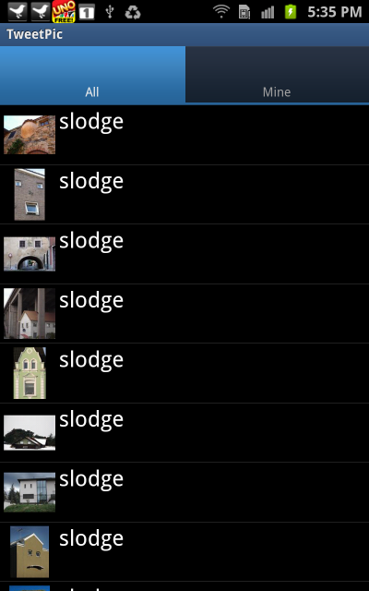
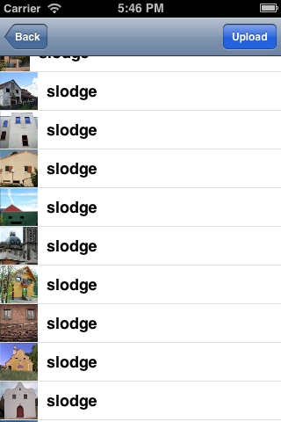
Sophistication: TweetPic clients

Slide 21
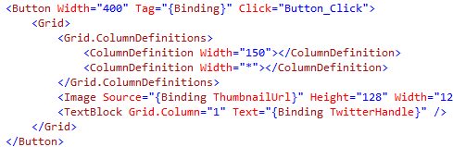
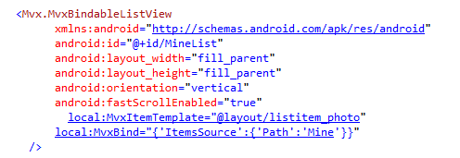
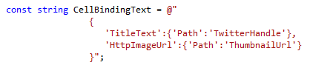
Declarative Presentation

Slide 22

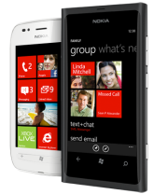
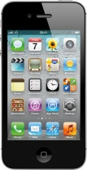
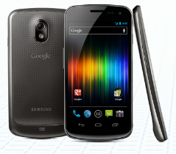
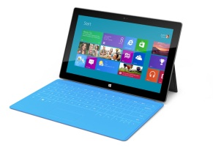
C# App Stack
Data Access
Business Logic
Presentation
Service Consumption
Local Data/Services
Business Logic
UI Logic
WP7
iOS
Droid
Win8

Slide 23
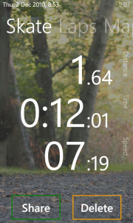
Examples: RunSat
SQL Server
Non Cloud
Web Site
Blob Storage

Slide 24
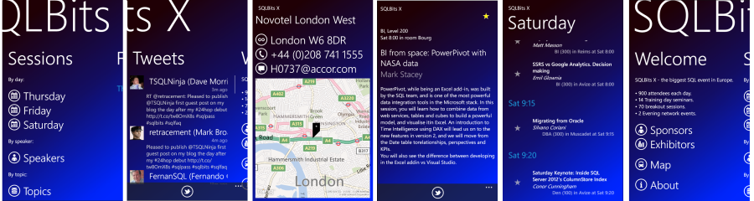
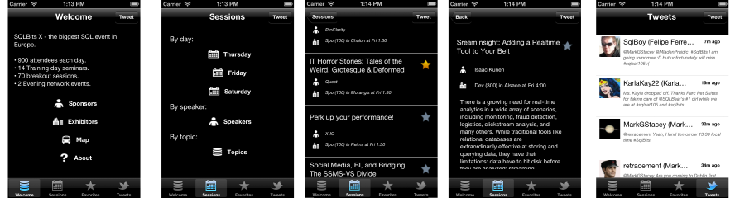
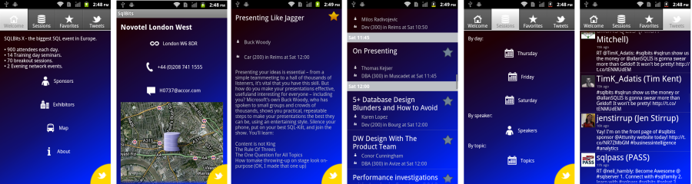
Examples: SQLBits Conference App

Slide 25
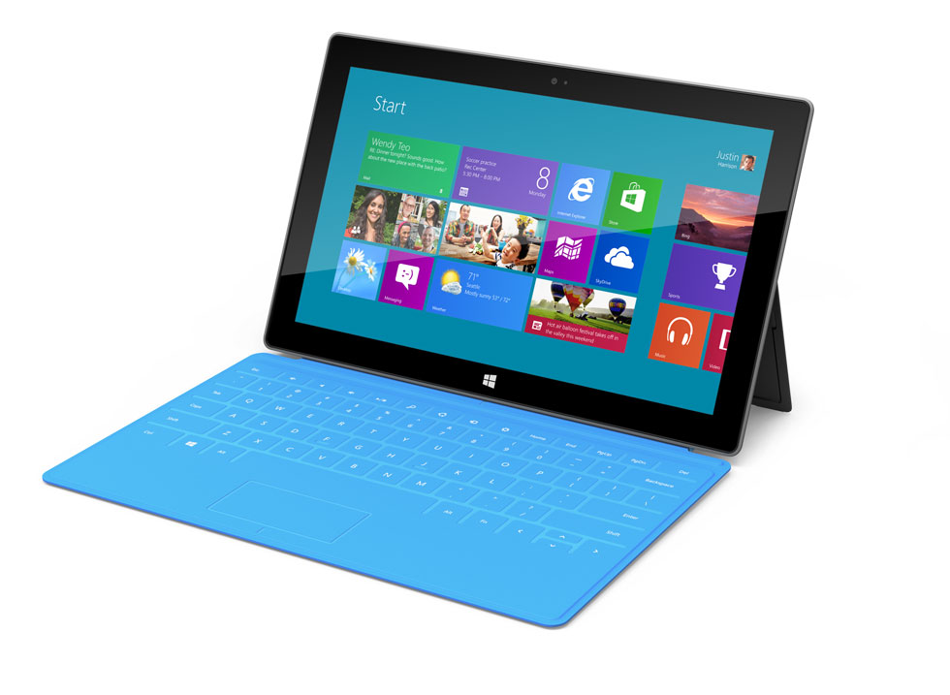
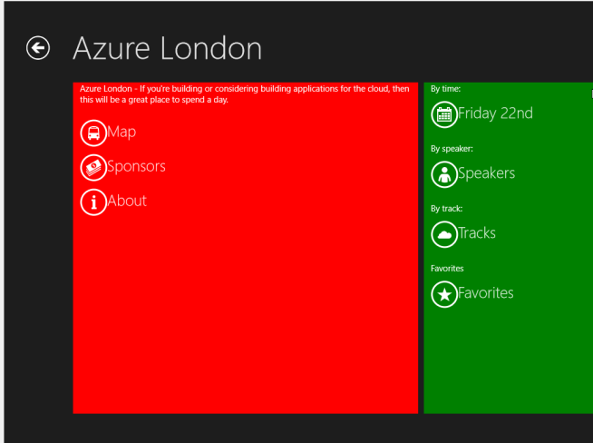
Examples: Azure London Conference App
Azure Website based
Service Download
Twitter Authentication
Checkin
Checkin Scoreboards
Photo Upload

Slide 26
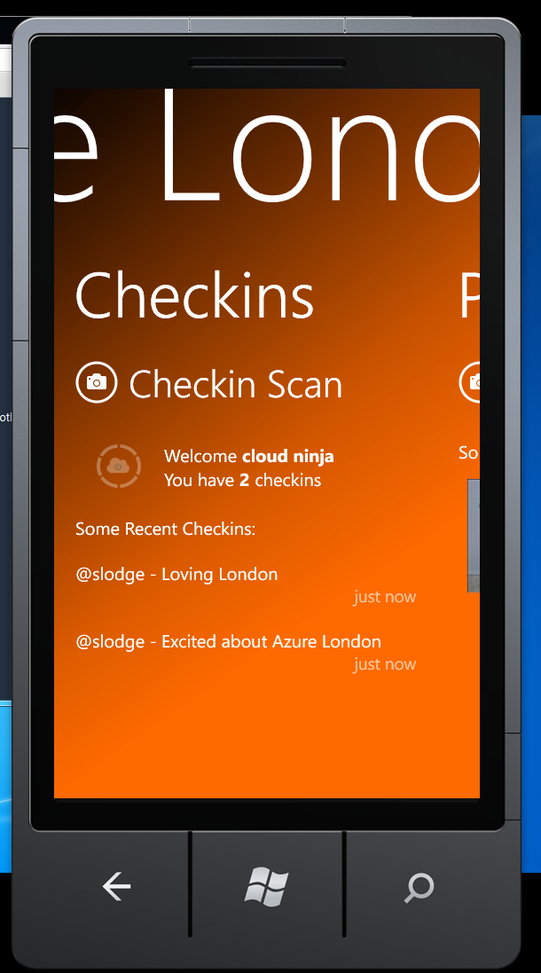

Example: Azure London Conference App

Slide 27


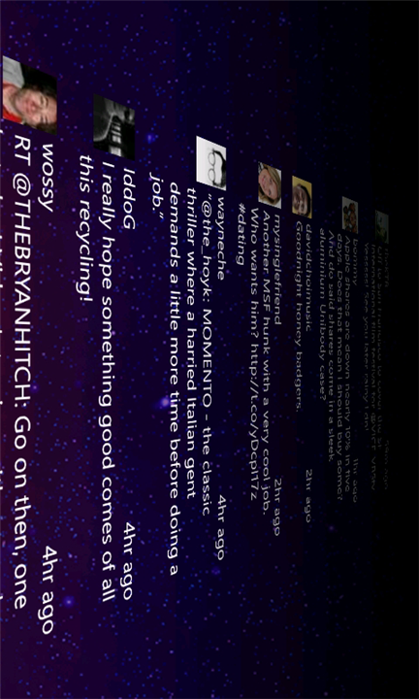
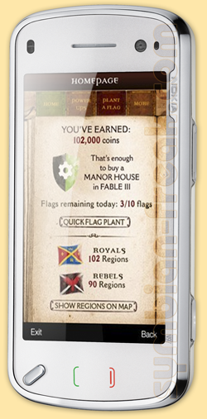
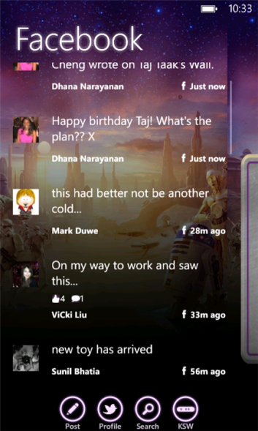
Examples: Xbox Advertising Apps

Slide 28
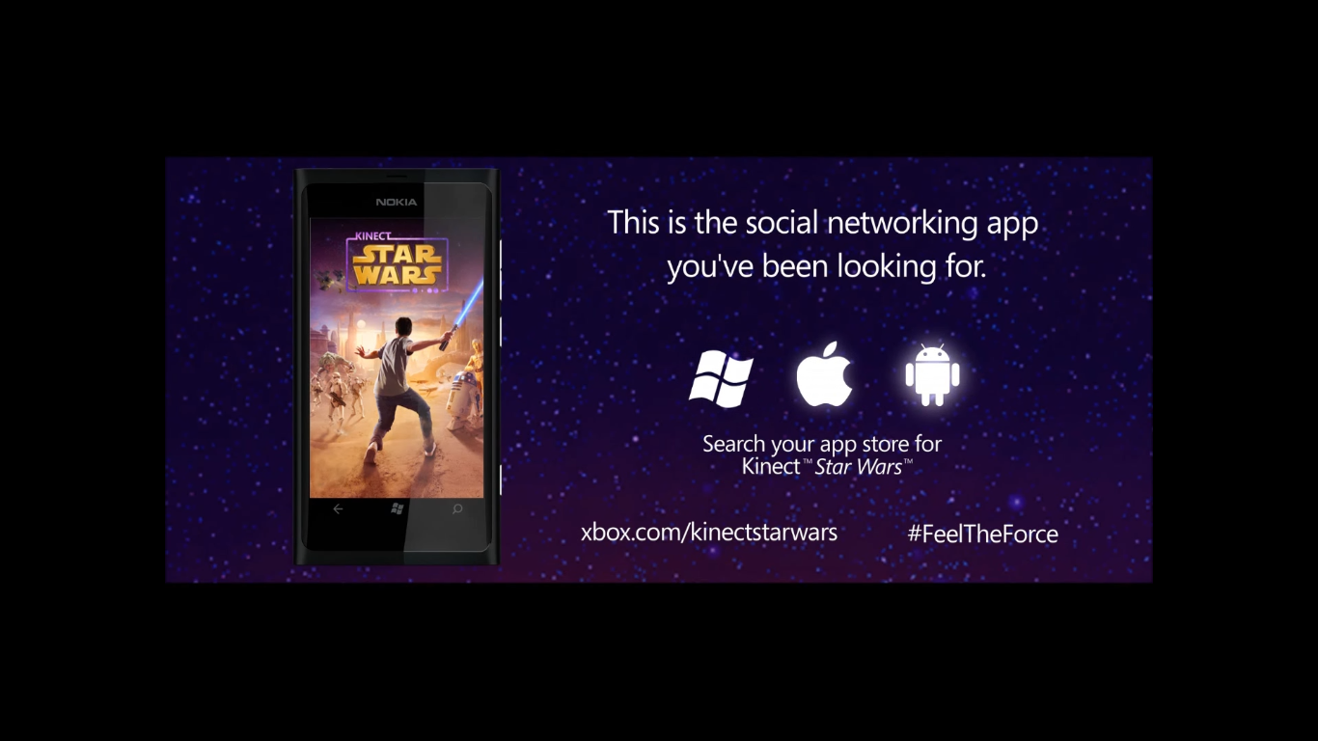
Example: Xbox Advertising Apps

Slide 29
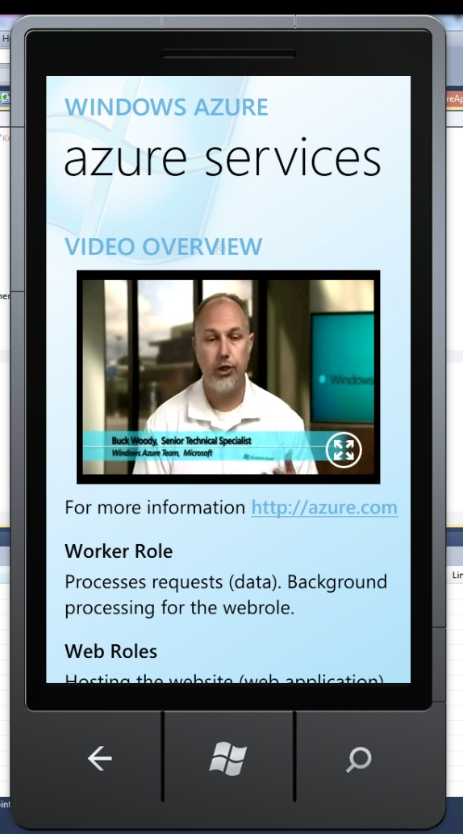
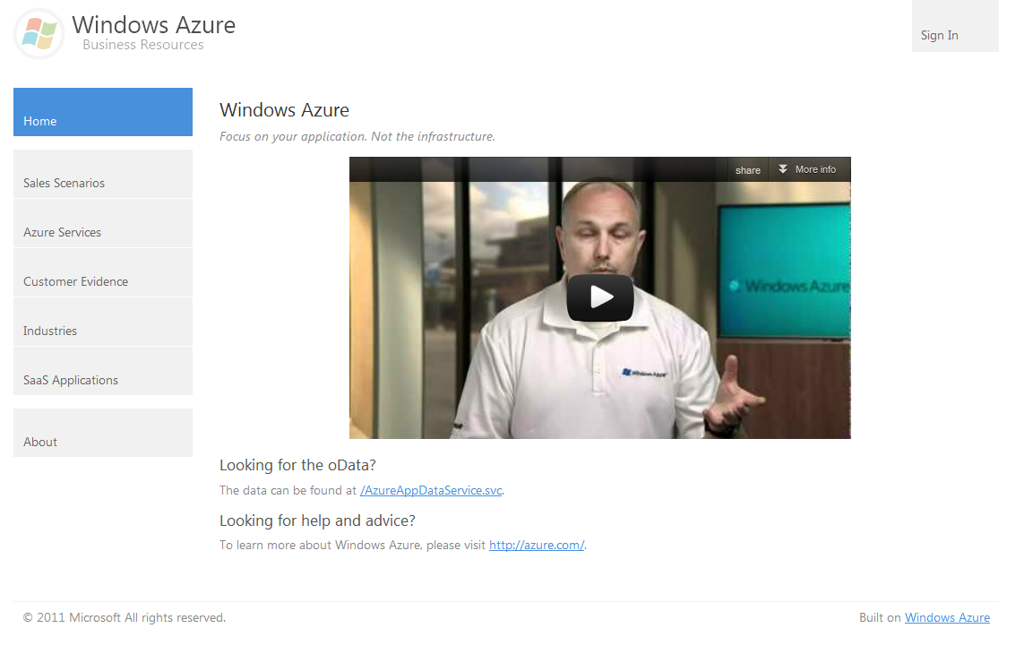
Examples: AzureApp

Slide 30
Recap
C# Cloud
C# Clients
C# Cloud-Client Communication
C# Code
Real App Examples
Q&A

Slide 31
For more info…
For server:
azure.com
Wade Wenger’s talks on WP7/Android/iOS toolkits
watwp.codeplex.com
For clients:
create.msdn.com
xaminars from xamarin.com
github.com/slodge/mvvmcross

Slide 32
@slodge

Slide 33

@slodge

Slide 34

@slodge

Slide 35

@slodge

Slide 36

@slodge

Slide 37

@slodge

